Slide 1
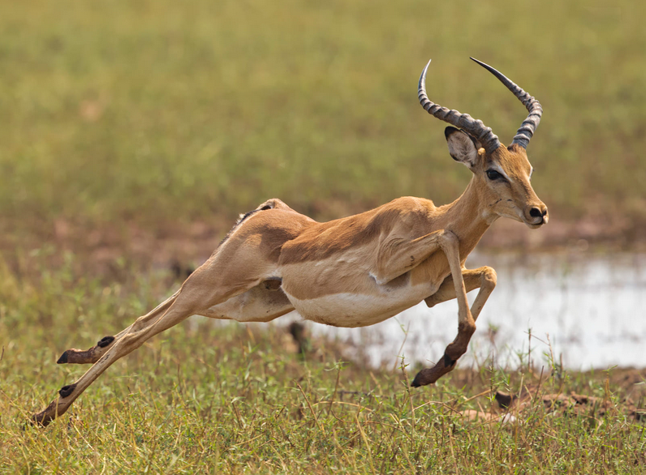
Linking individual energetics to biodiversity
Ken Watkins
iStock

Slide 2








How do animals balance their individual energetic needs to maximize survival and reproduction (in changing environments)?
stay warm, healthy, move, eat, reproduce, survive
&
The link between individual energetics and population and community dynamics?

Slide 3
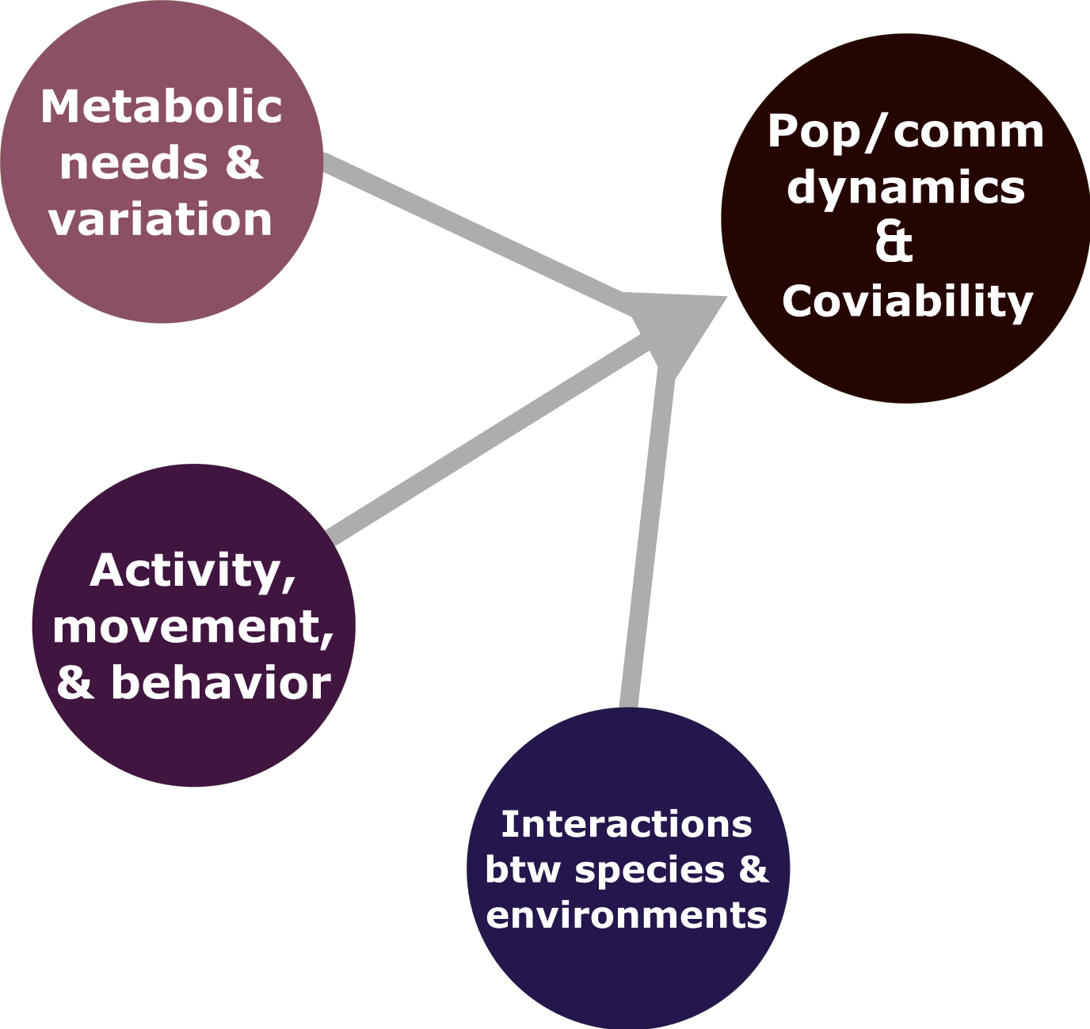

Slide 4
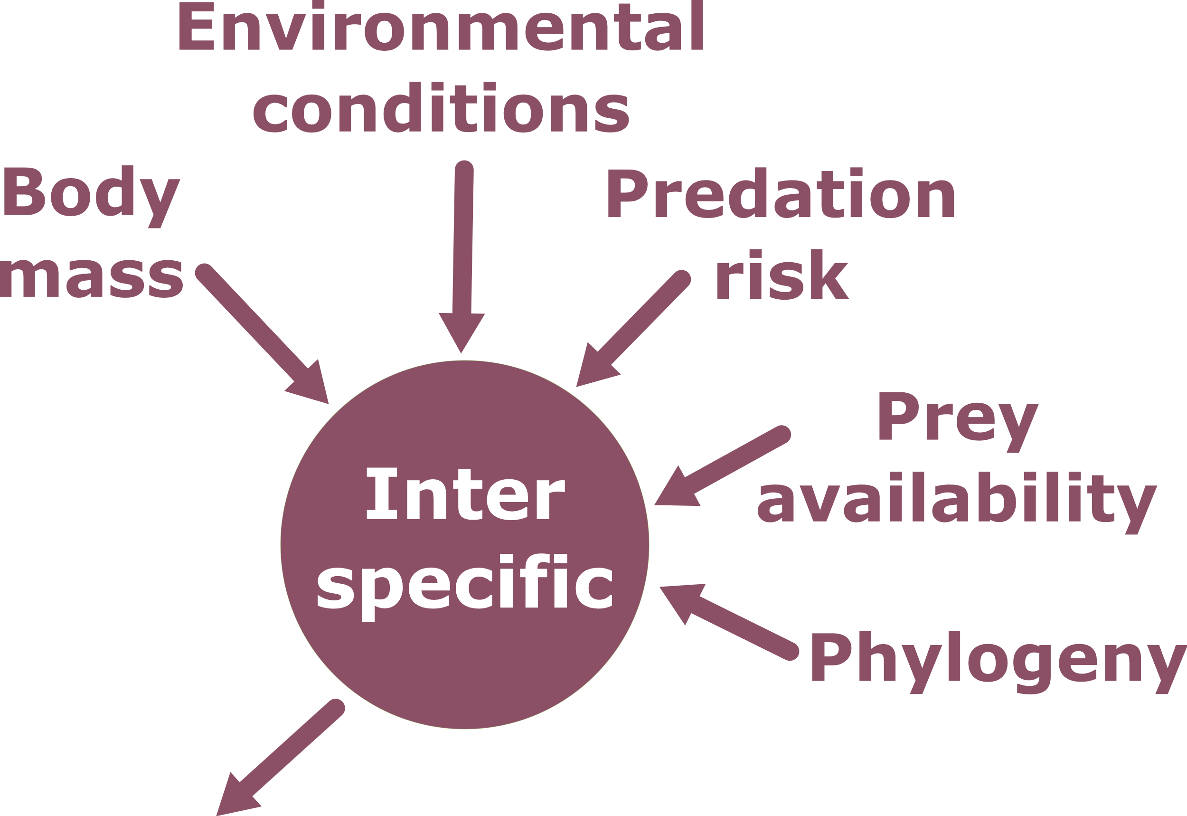
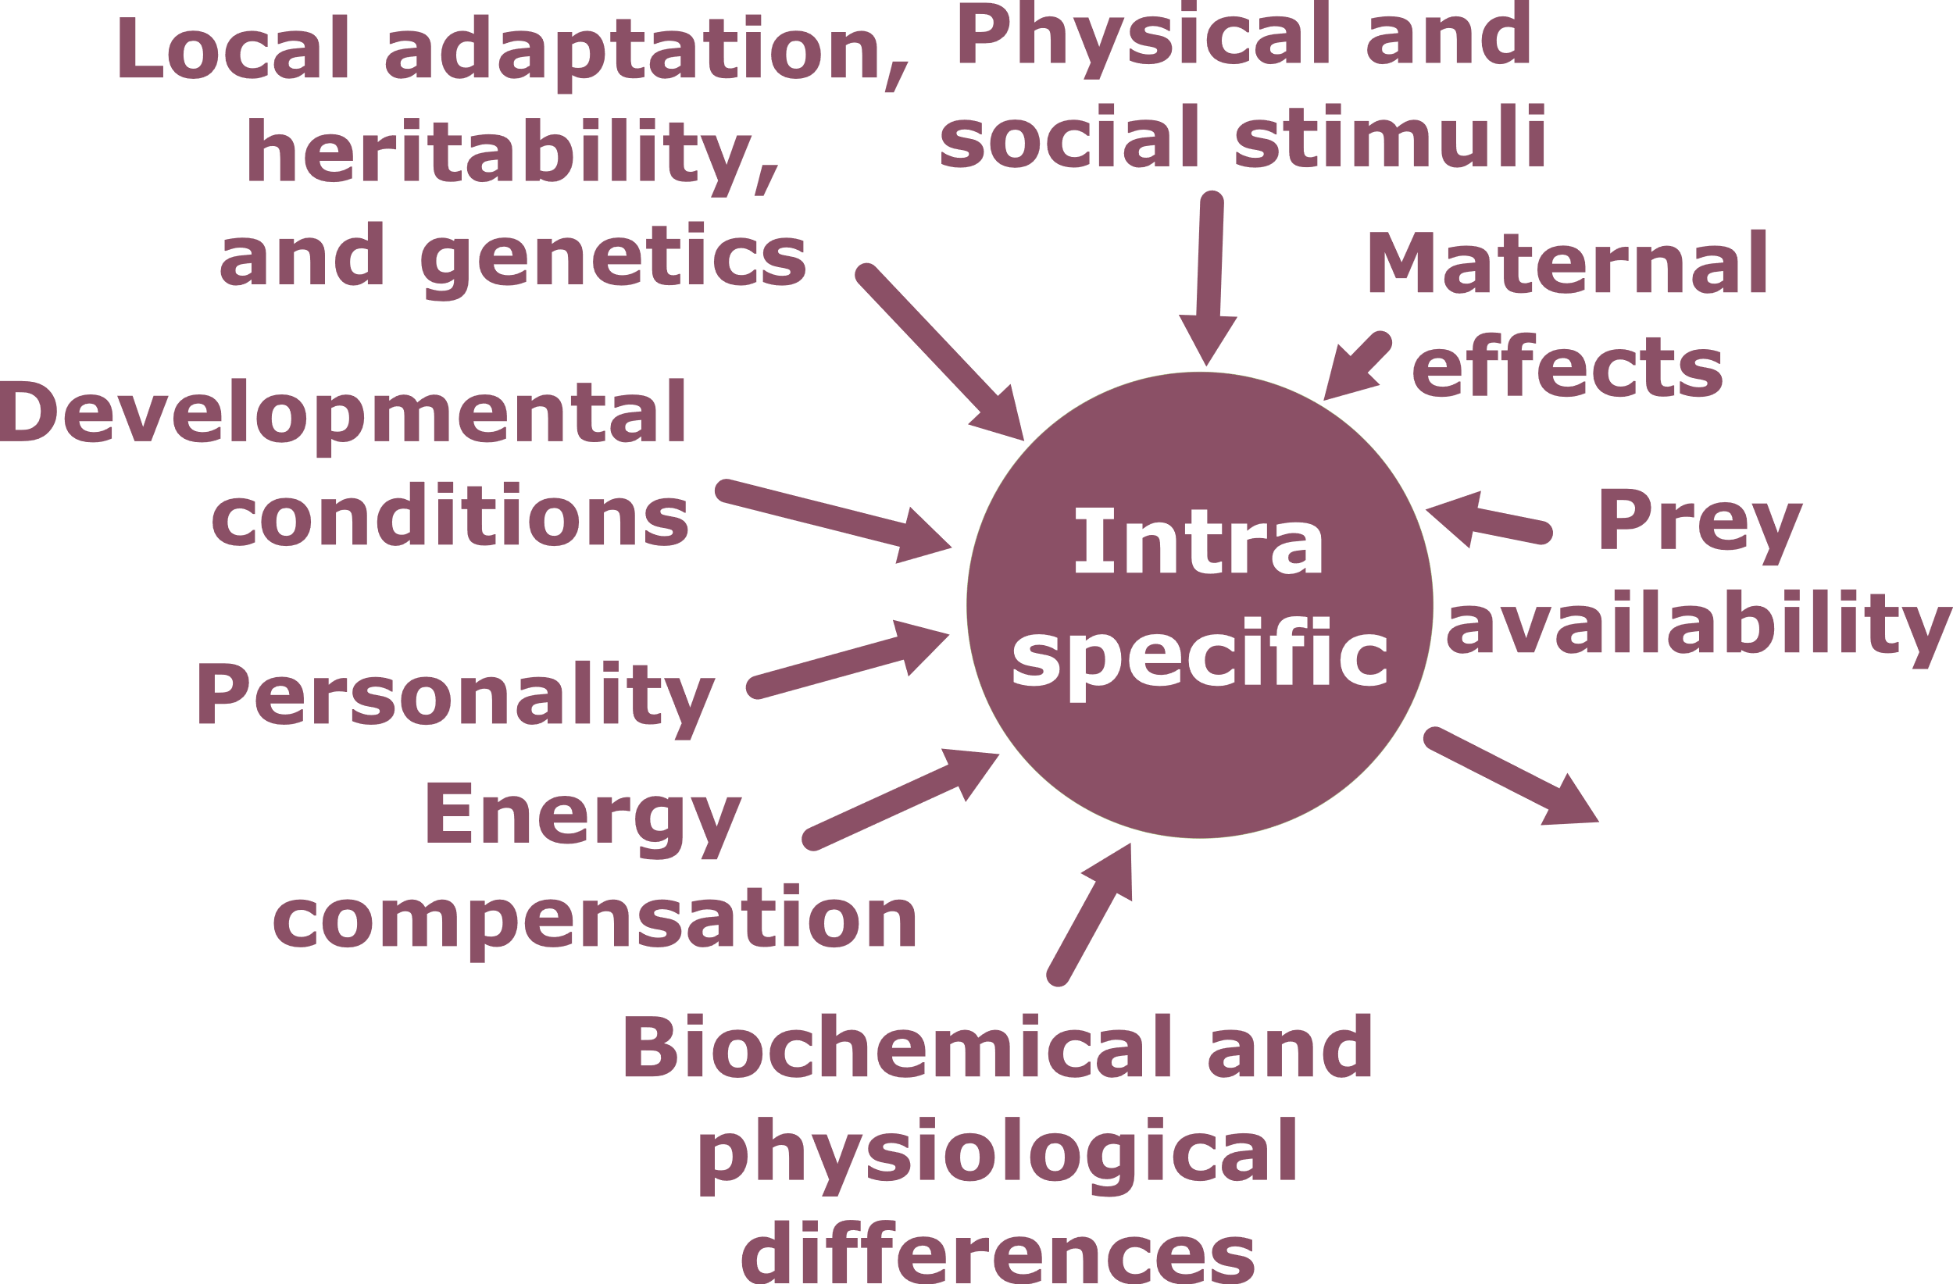
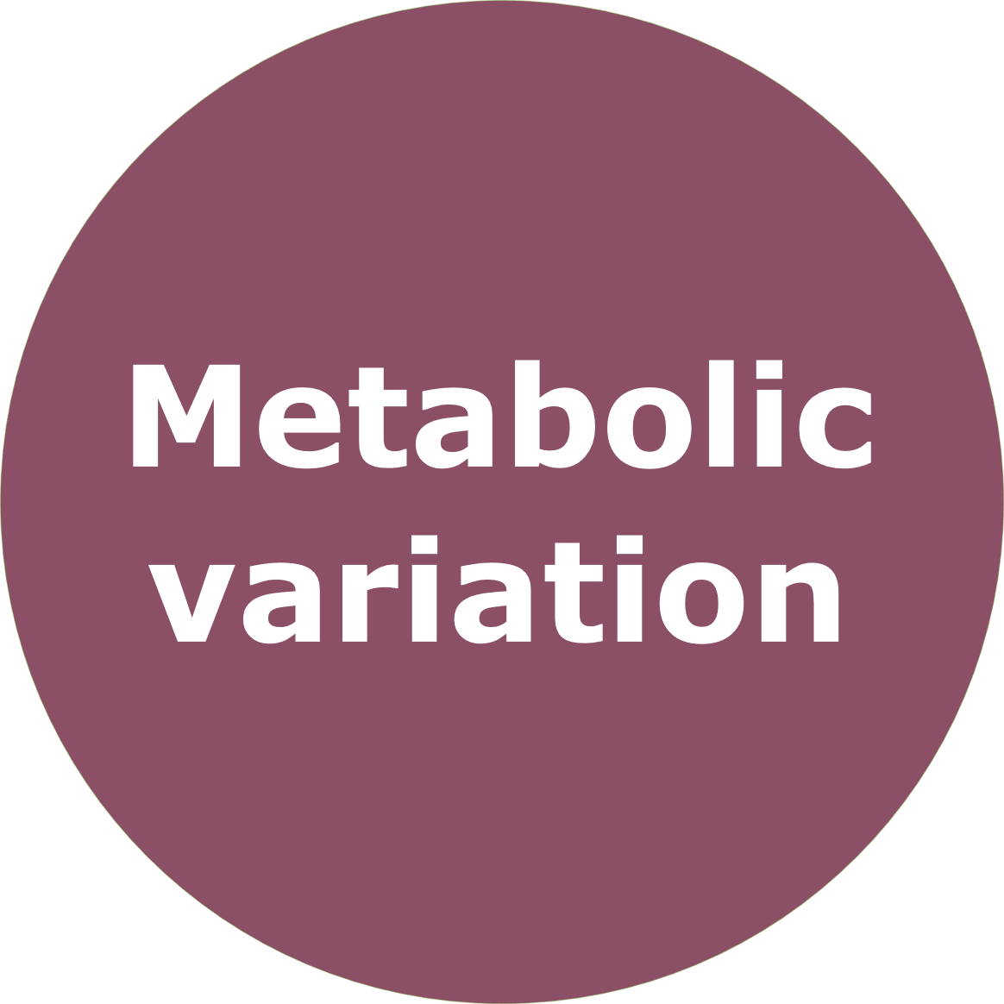

Slide 5
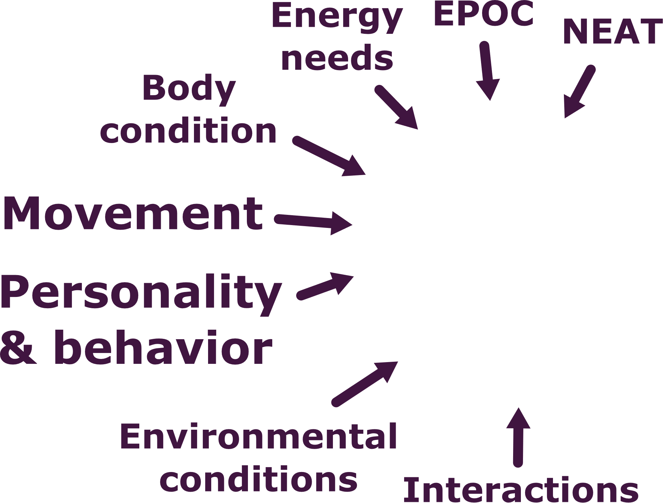


Slide 6
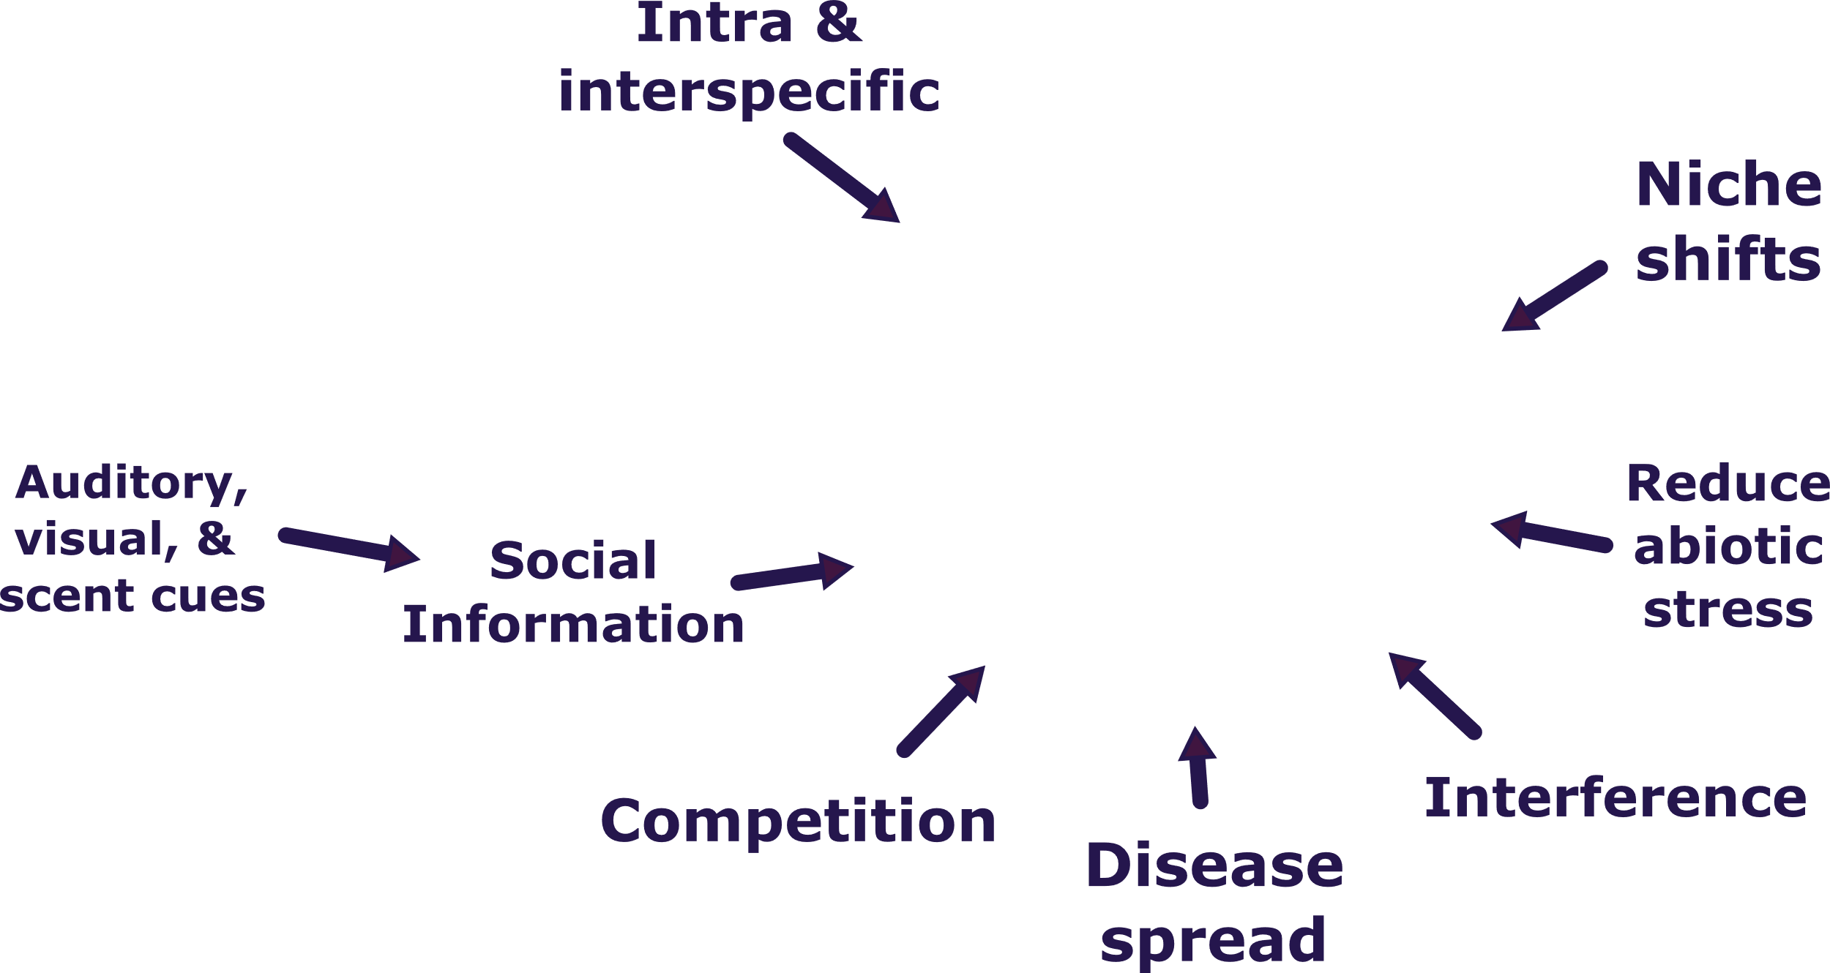


Slide 7
Some inspiration…

Slide 8
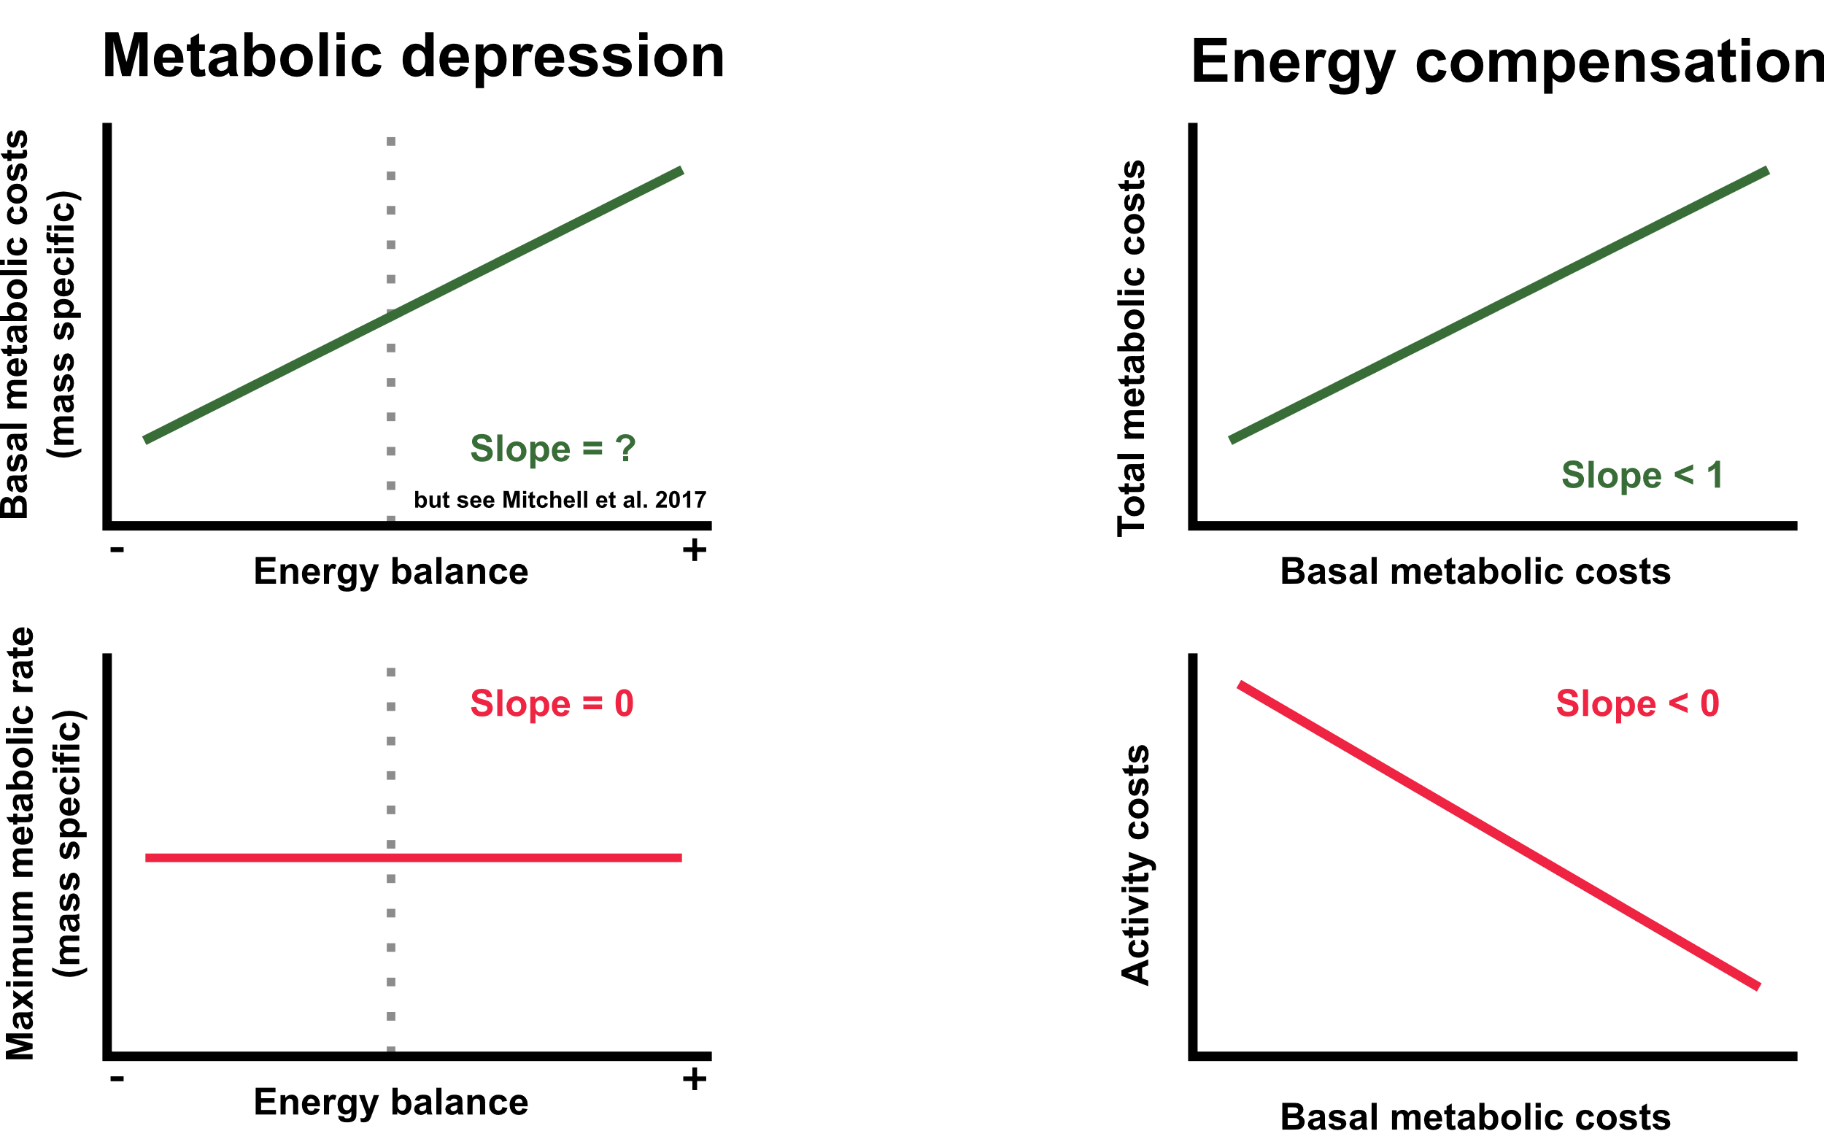
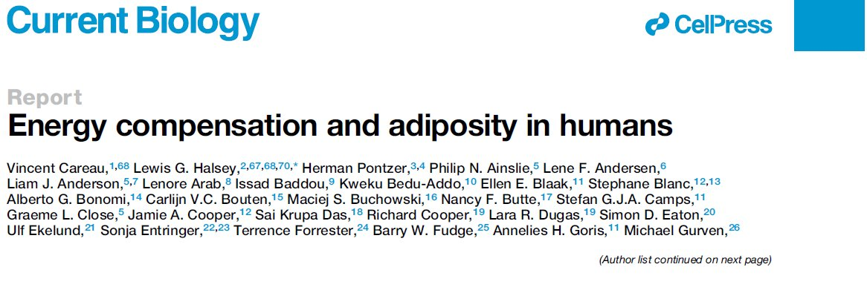
Individual flexibility in energetic rates?

Slide 9
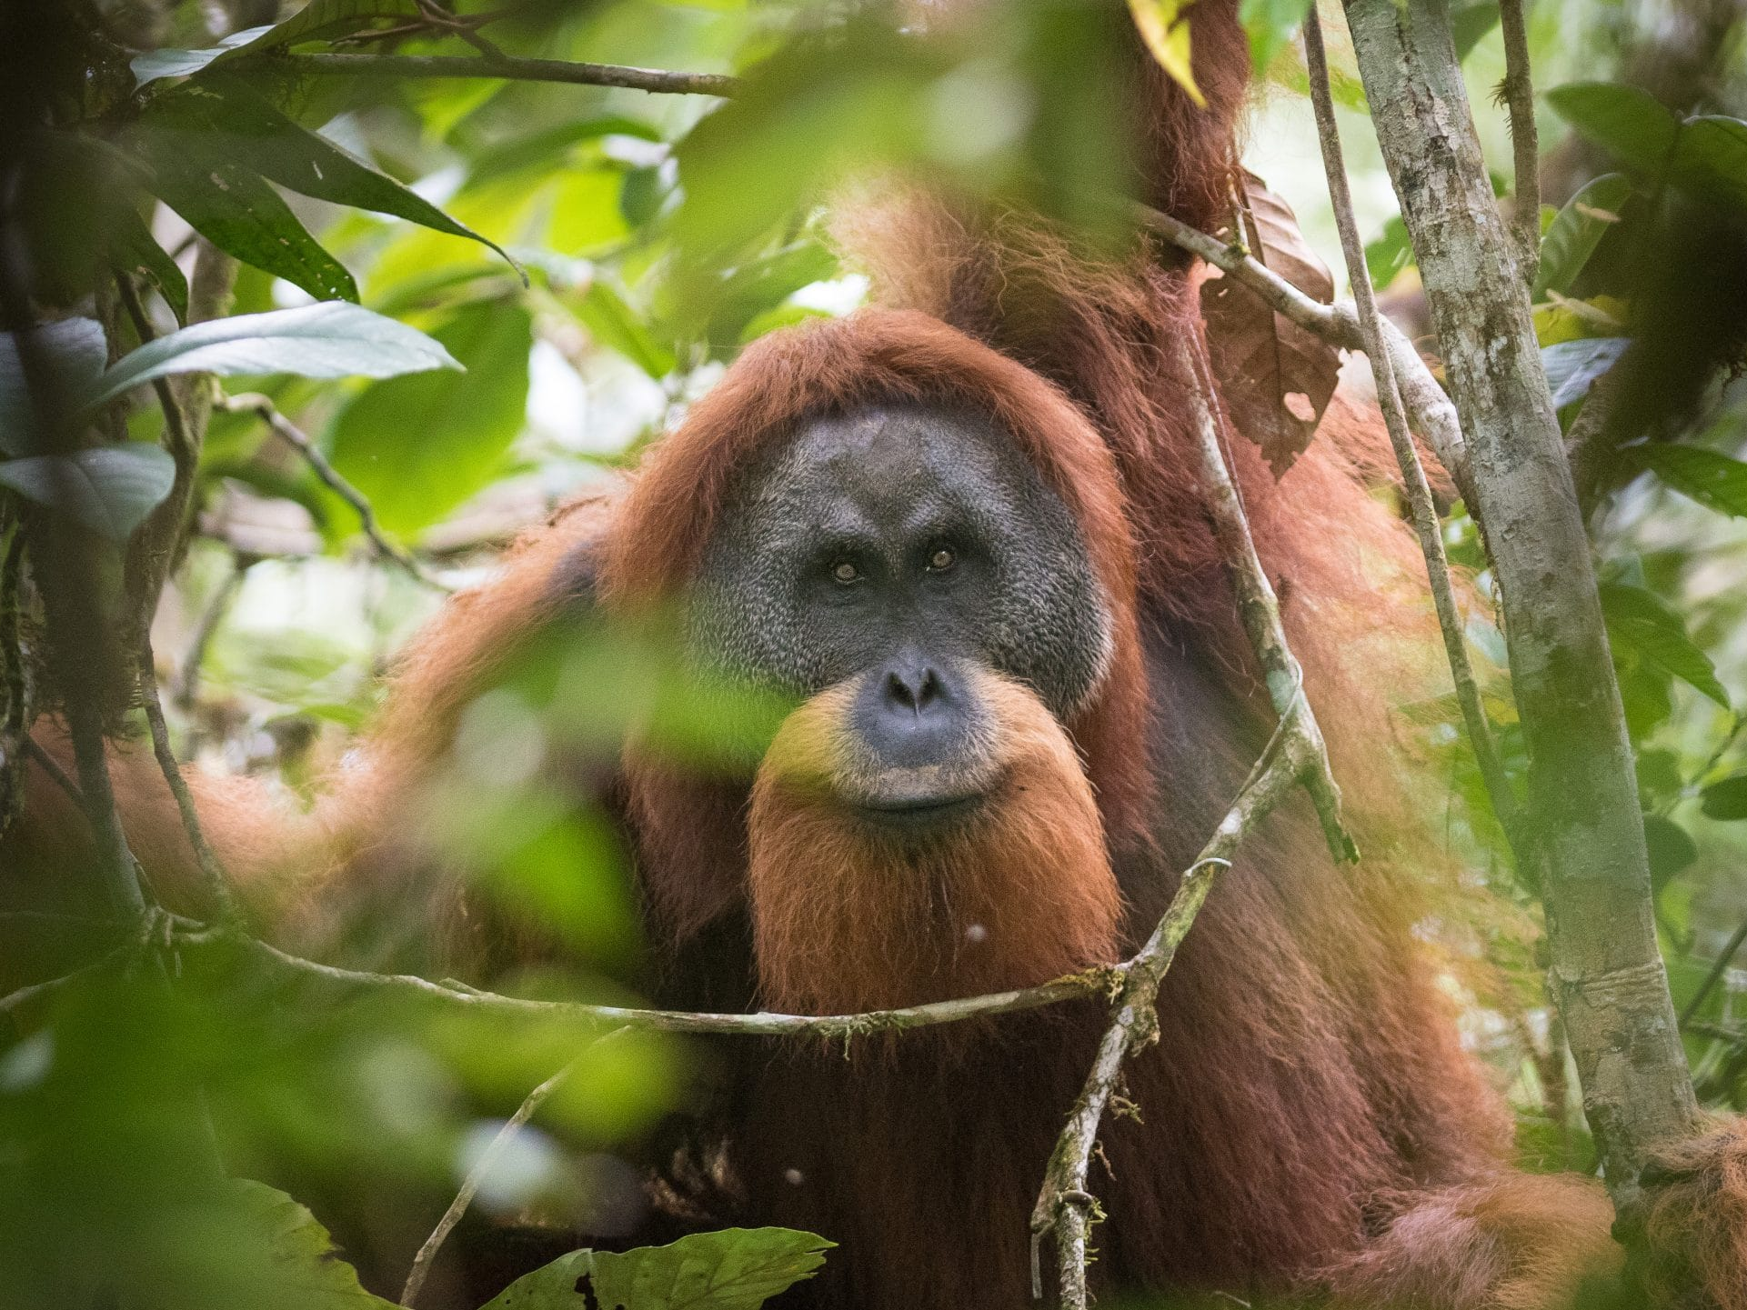
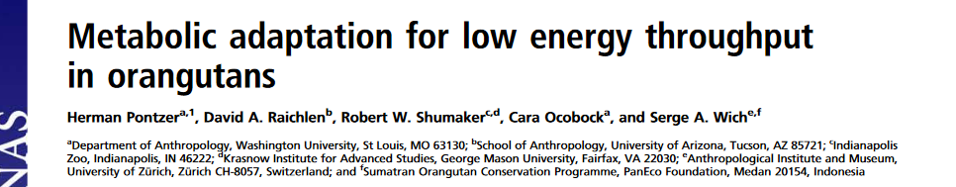
© Andrew Walmsley Photography
“…orangutans used less energy, relative to body mass, than nearly any eutherian mammal ever measured. Such an extremely low rate of energy … is consistent with the slow growth and low rate of reproduction in orangutans, and may be an evolutionary response to severe food shortages in their native Southeast Asian rainforests.
How are species shaped by their environments?

Slide 10
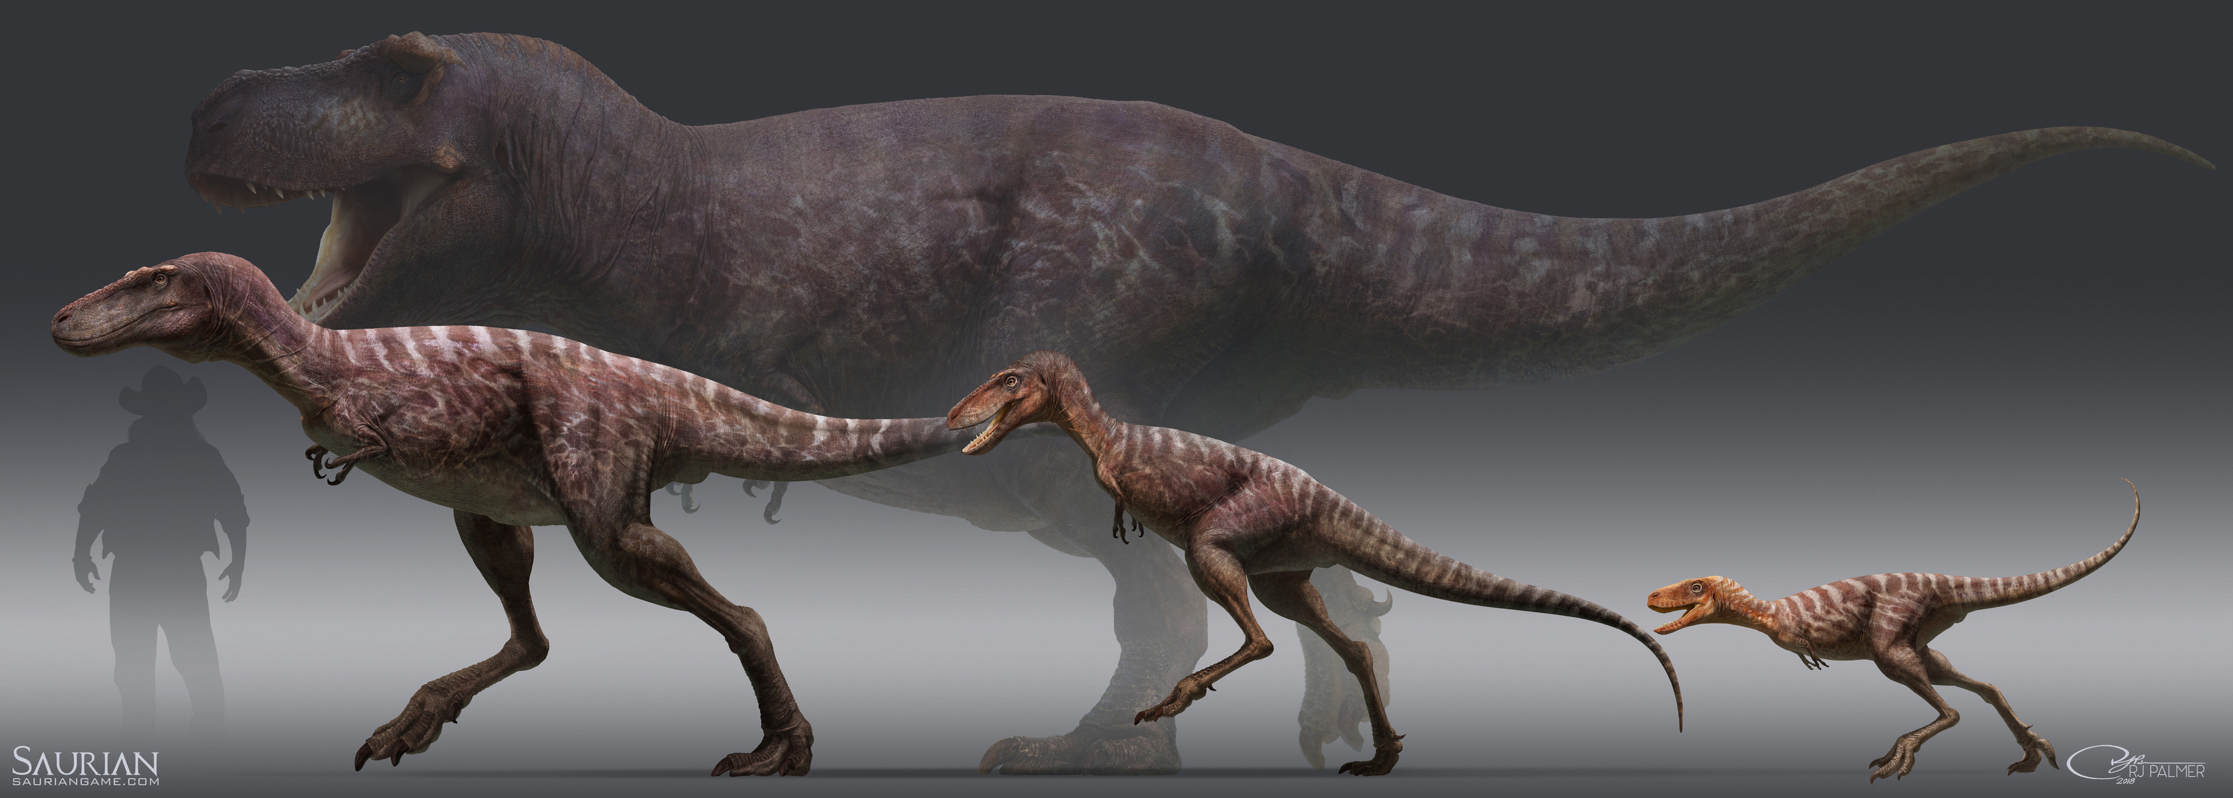
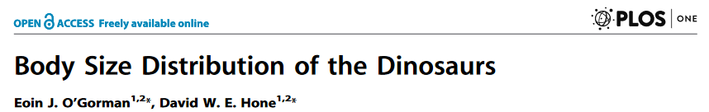
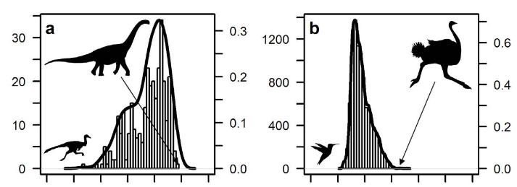
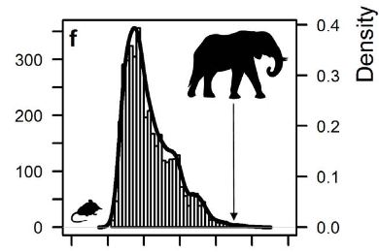
What is the role of metabolic/energetic niches?
“Herbivorous dinosaurs rapidly evolved large size to escape predation by carnivores and maximise digestive efficiency; carnivores had sufficient resources among juvenile dinosaurs and non-dinosaurian prey to achieve optimal success at smaller body size”

Slide 11
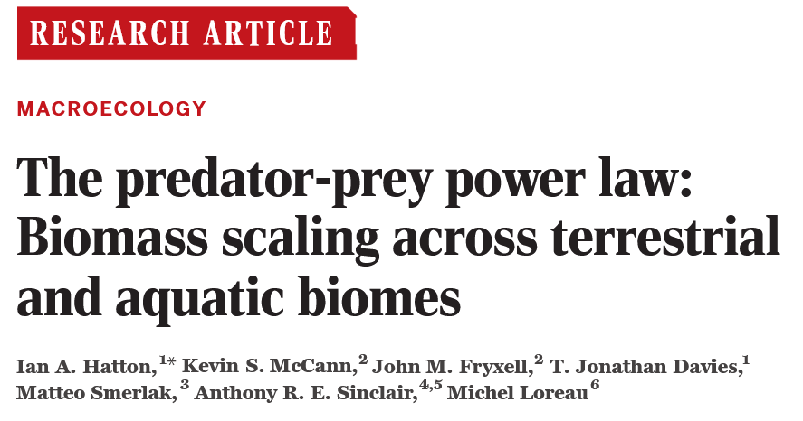
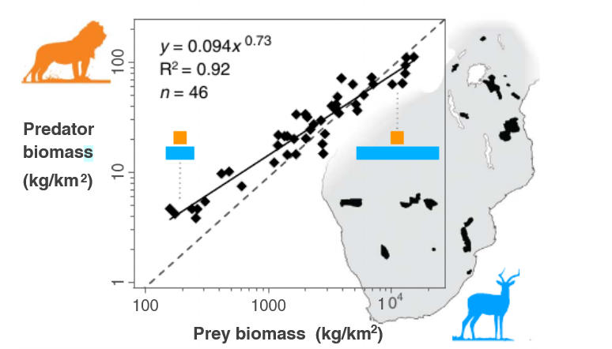
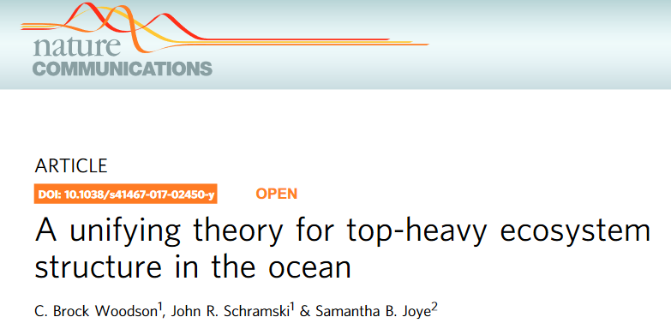
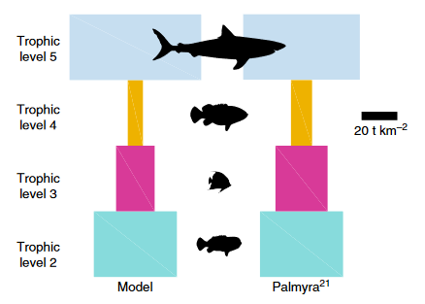
The role in shaping ecosystem structure
“…predator and prey biomass follow a general scaling law with exponents consistently near ¾. This pervasive pattern implies that the structure of the biomass pyramid becomes increasingly
bottom-heavy at higher biomass.”
“…generalist predatory behavior and lower trophic feeding at large body size increase overall biomass and shift ecosystems from a bottom-heavy pyramid to a top-heavy hourglass shape…”

Slide 12
A potential
framework…

Slide 13
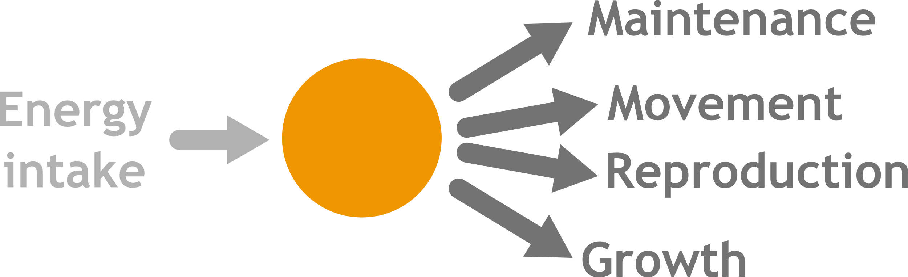
How do differences in energetics lead to coviability?

Slide 14



How do differences in energetics lead to coviability?

Slide 15


The ecosystem

Slide 16
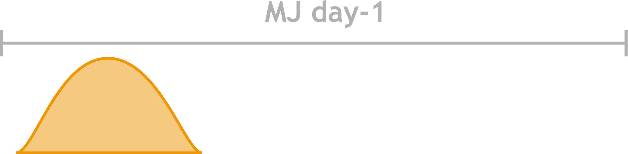
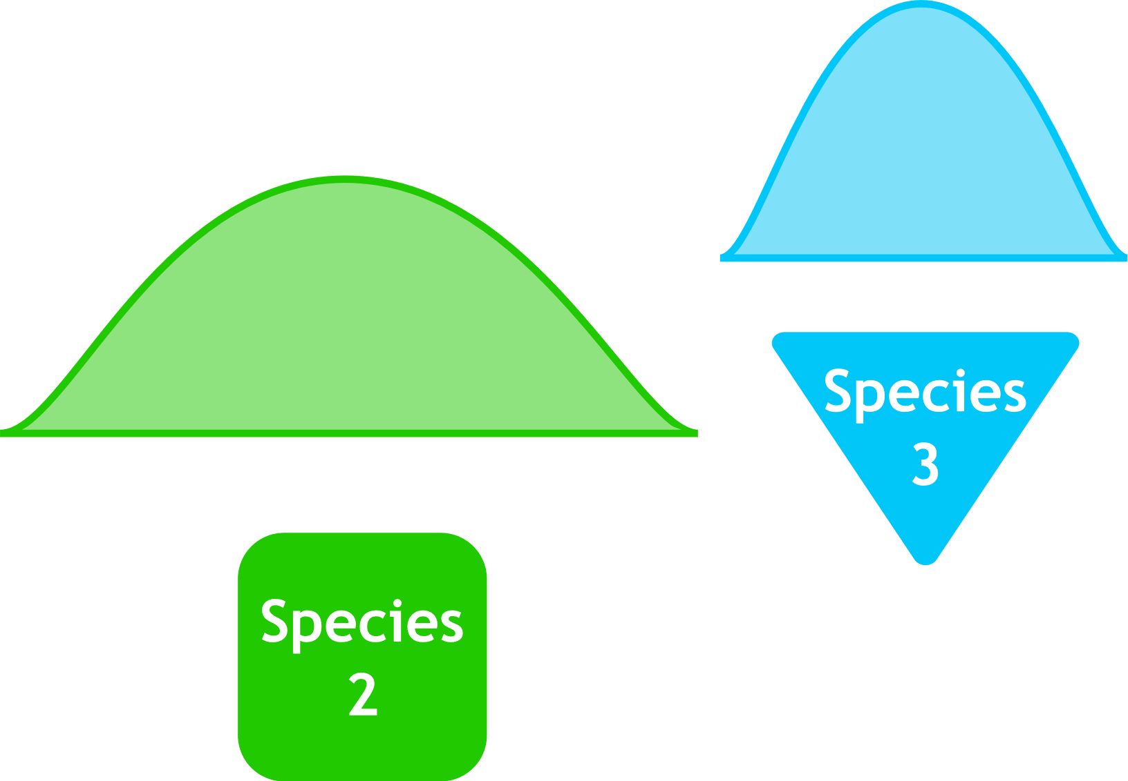
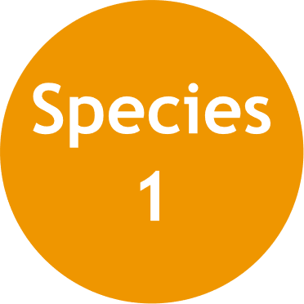



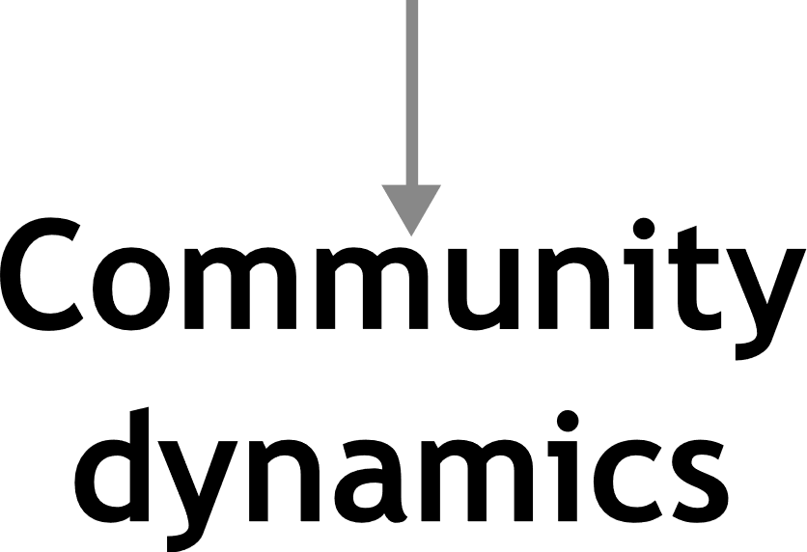

Slide 17
How do animals' unique physiologies make them more or less vulnerable to environmental change?
How does the context dependence of benefits of metabolic variation maintain individual variation?
How does the environment and the interactions between species shape their metabolisms? And the reverse?
How does food scarcity impact communities (changes in movement and other behaviors)?

Slide 18
Key gaps
Consideration of
activity costs
Inclusion of
metabolic variation
Individual-based link between
Individual energy use and
community dynamics

